Slide 1
Support Vector Machines
Ryan Pacheco

Slide 2
Overview
Uses hyperplane
Split and optimize the hyperplane separating classes
The SVM makes decisions based on what side of the hyperplane a class falls on
The side of the split hyperplane a data point falls on determines its class

Slide 3
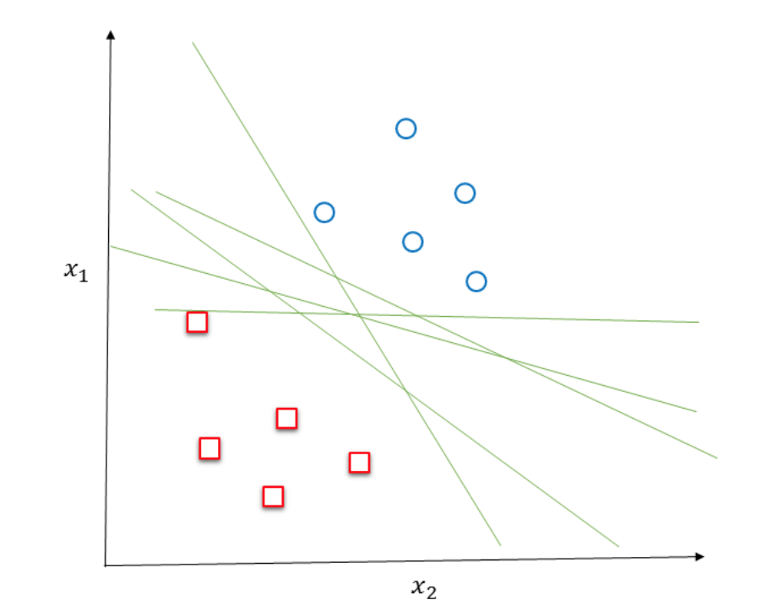

Slide 4
SVM Math
Hyperplanes defined by:
W * X + b = 0
W = weight vector
W = {w1, w2, …, w3}
B = intercept or bias
X = support vectors

Slide 5
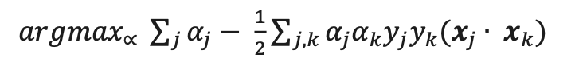
Optimize the Hyperplane
Search decision space for W and b using gradient descent
αj ≥ 0 and ∑𝑗 𝛼𝑗𝑌𝑗 = 0

Slide 6
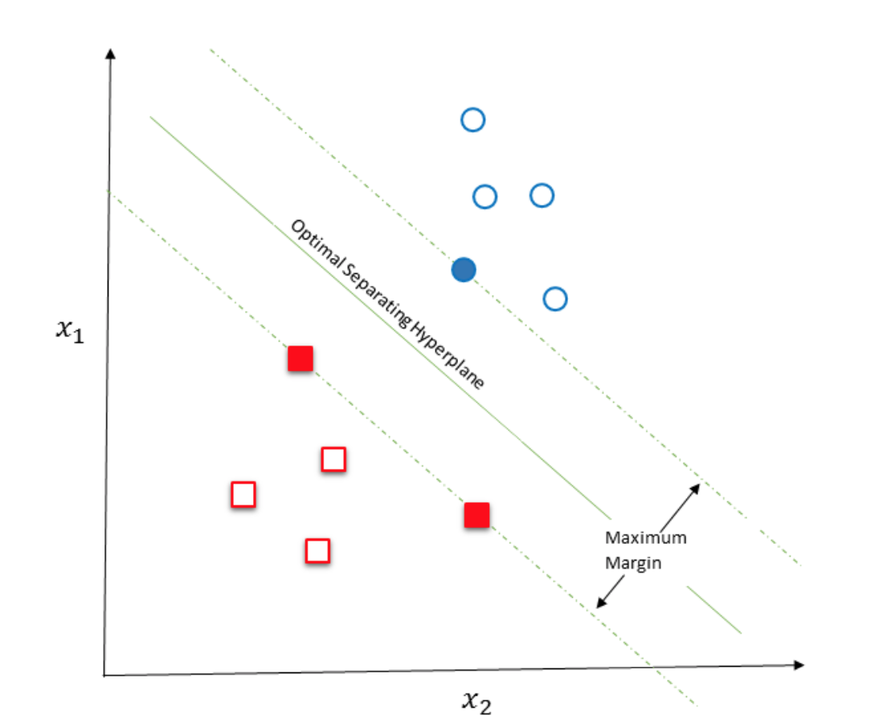

Slide 7
SVM
Susceptible to overfitting
Balance training data
Really good for binary classification
Optimized hyperplane makes it more reliable than logistic regression
More complicated than logistic regression
2 steps:
Convert original data into linearly separable decision space using nonlinear mapping
Search the new higher dimensional space for an optimal separating hyperplane

Slide 8
Curse of Dimensionality
Mapping data to higher dimensional space isn’t always a good idea
Can increase classification complexity and intensity
Can increase the time it takes to classify data
Only map to a higher dimension if the training data is not already linearly separable

Slide 9
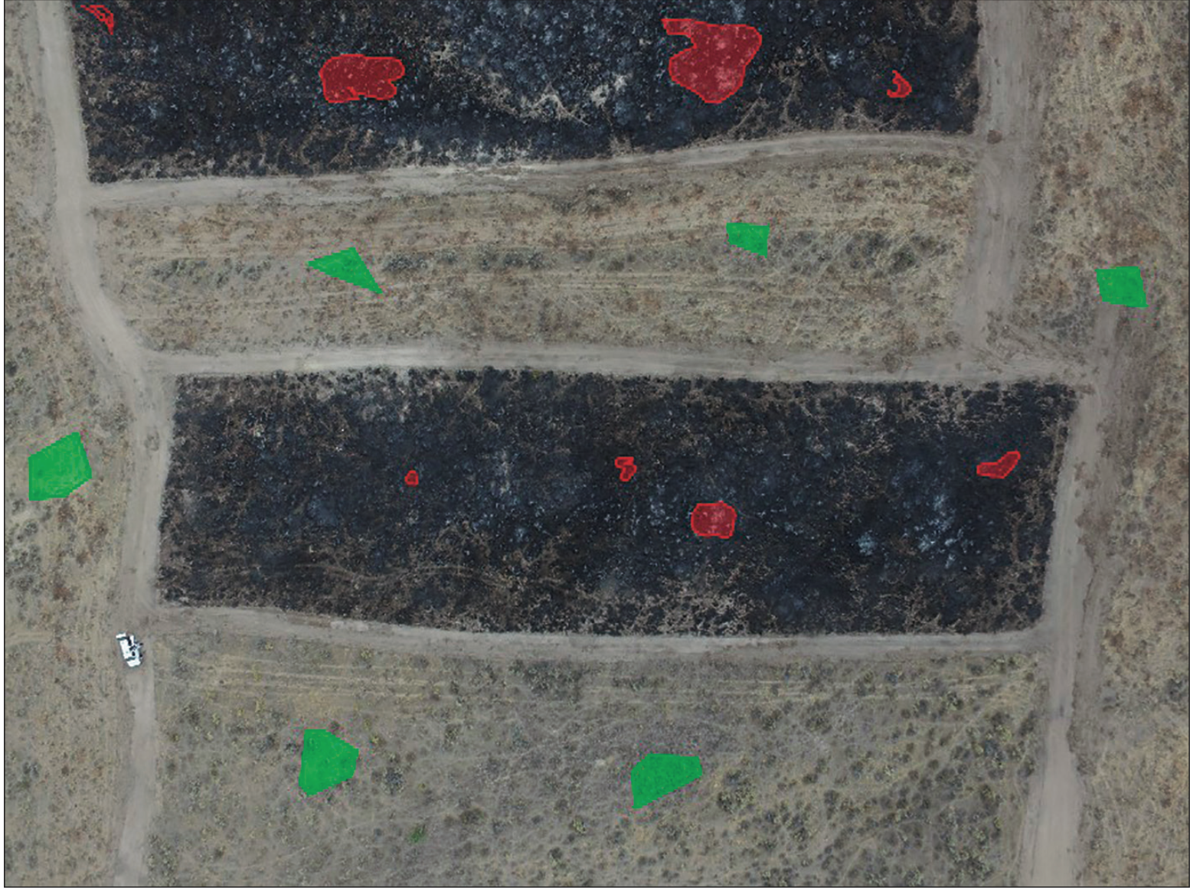

Slide 10
